Slide 1
Z-Voting
Developer: Amir Ekbatanifard
Mail: amirekbatani75@gmail.com
GitHub: www.github.com/AMIRKHANEF

Slide 2
Z-Voting
A Complete anonymous Voting framework
Using zero-knowledge proof
Private Voting
Implement in smart contract (SOLIDITY)
Upgradeable
Can be used on any blockchain that supports solidity smart contracts
High security
Can be used on main net
Reusable
1

Slide 3
Groth16 - Circuit
A circuit produces a series of outputs for a series of inputs.
A proof is the correct execution of a particular circuit.
Verifier enters the public input
Prover enters the private inputs
Private
Public
Circuit
Circom circuit
Inputs
Outputs
Proof
2

Slide 4
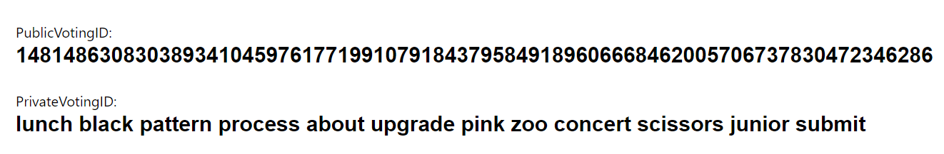
Privacy
Public VotingID
Private VotingKey (for signing)
Every voter must have:
Private Voting KEY
(mnemonic)
Public Voting ID
Pedersen Hash
3

Slide 5
Security
Powerful zero-knowledge proof
Immutable verifier
Merkle tree of voters
LEAF = Public Voting ID
4

Slide 6
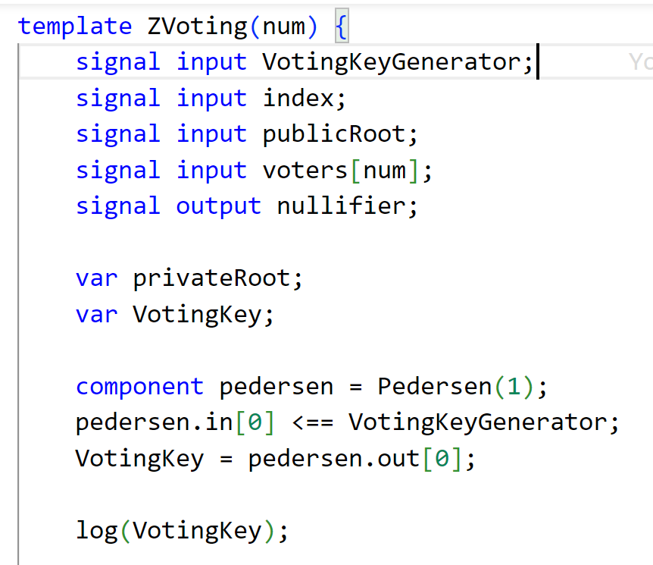
Authentication
Public inputs:
VotingIDs
MerkleTree root
Private inputs:
VotingKey
The output of this circuit is a proof, which proves that the person is eligible to vote.
5

Slide 7
Authentication (Cont.)
Prover(Voter):
Function (votingKey){
votingID = Pedersen(votingKey);
if(merkleTreeRoot.includes(VotingID){
return youHavePermissionToVote;
} Else {
return youHaveNotPermissionToVote;
}
}
6

Slide 8
Authentication (Cont.)
Verifier(Smart Contract):
Function Vote() {
require: Verifier(proof) to be true;
(alreadyVoted)
? (yes) { return false;}
: (no) { submitVote}
}
7

Slide 9


Aye:
0
1
0
Nay:
Vote
Vote
8

Slide 10
9

Slide 11
Let’s see a demo

Slide 12
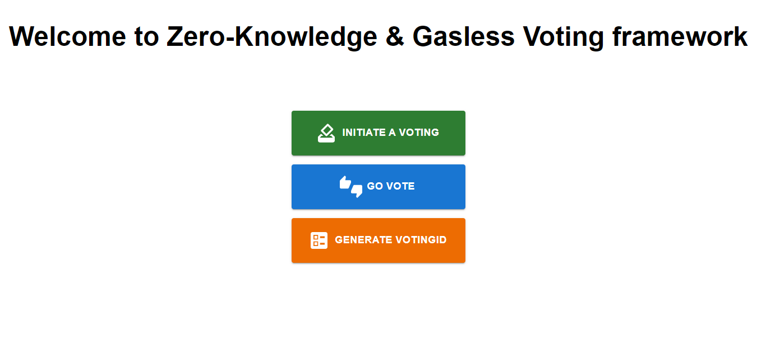

Slide 13
Generate a VotingID

Slide 14
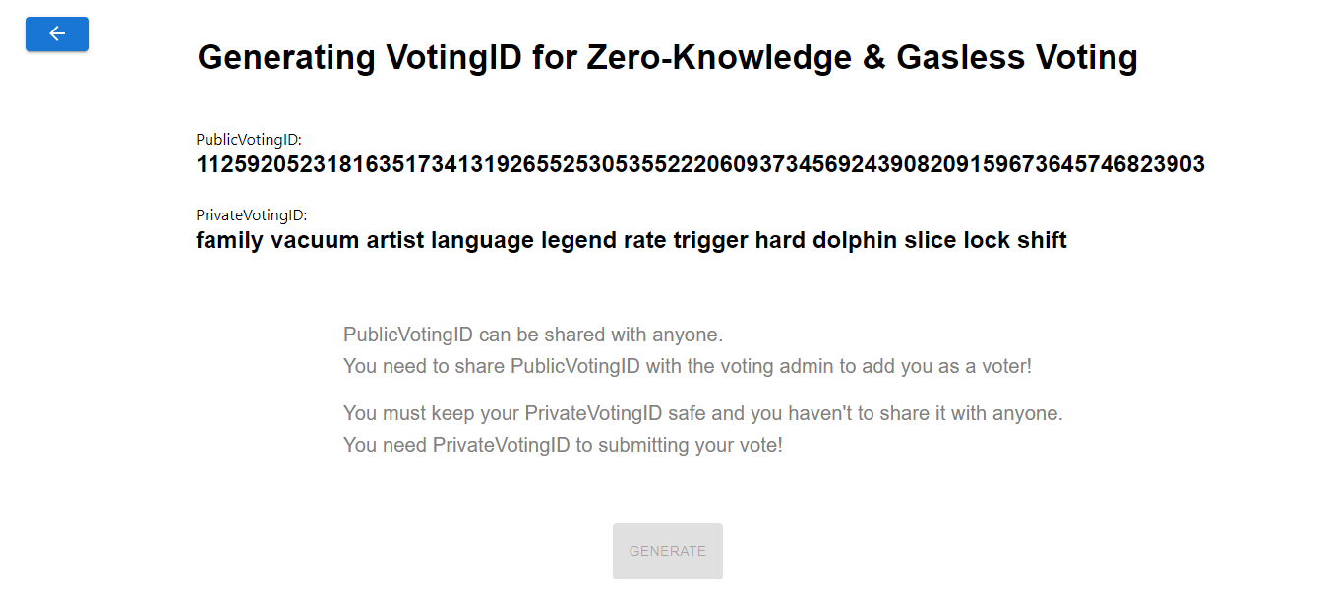

Slide 15
Initializing a voting

Slide 17
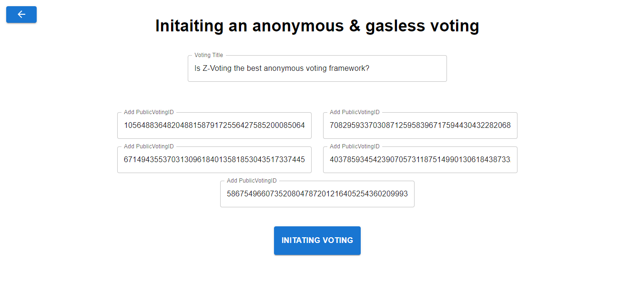

Slide 18
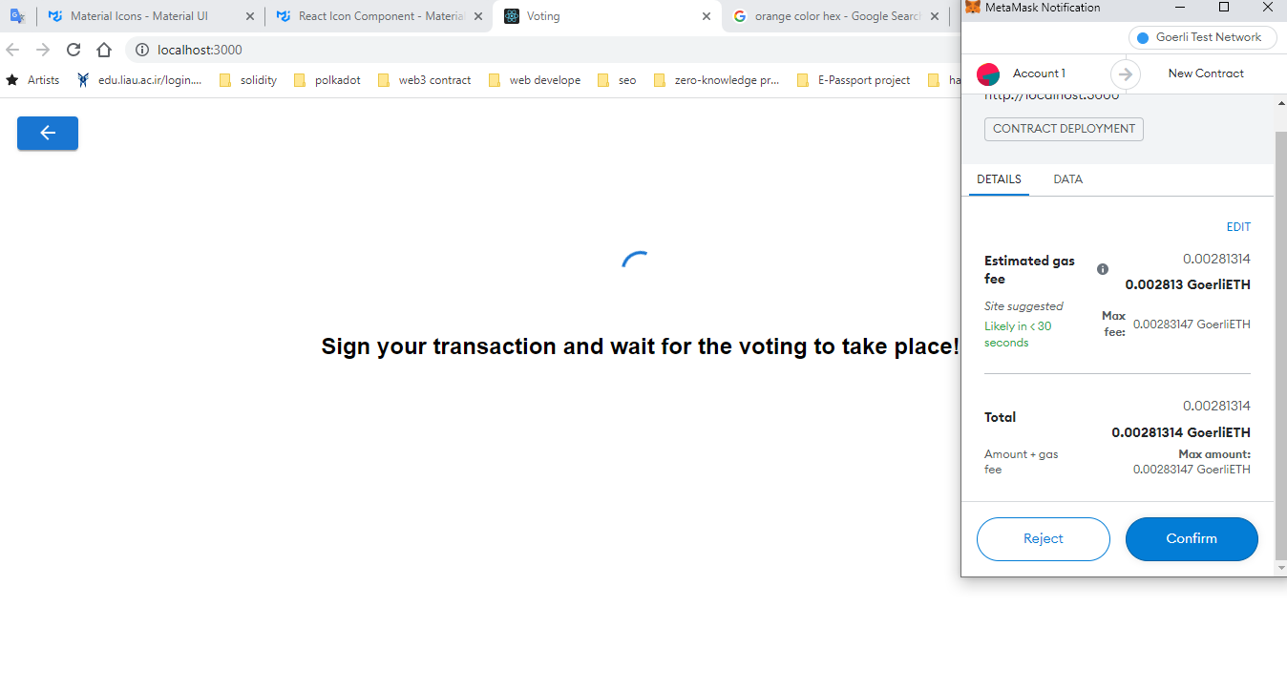

Slide 19
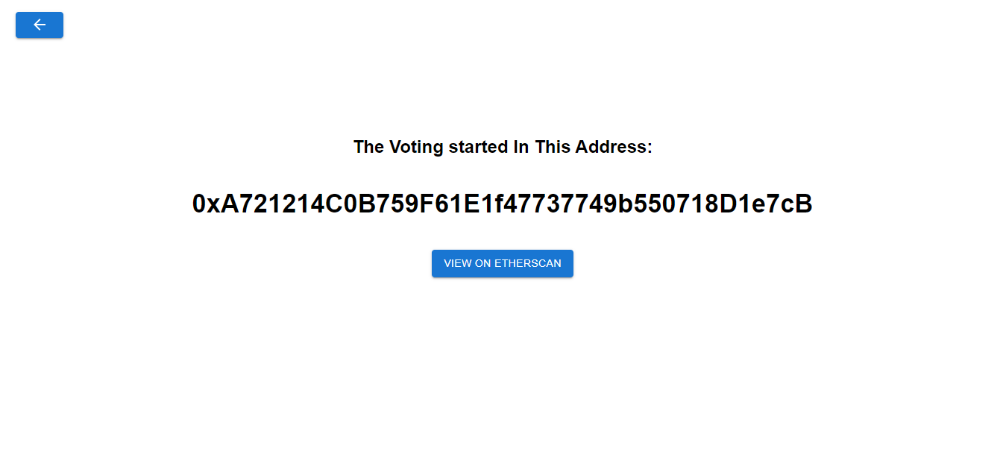

Slide 20
Vote

Slide 22
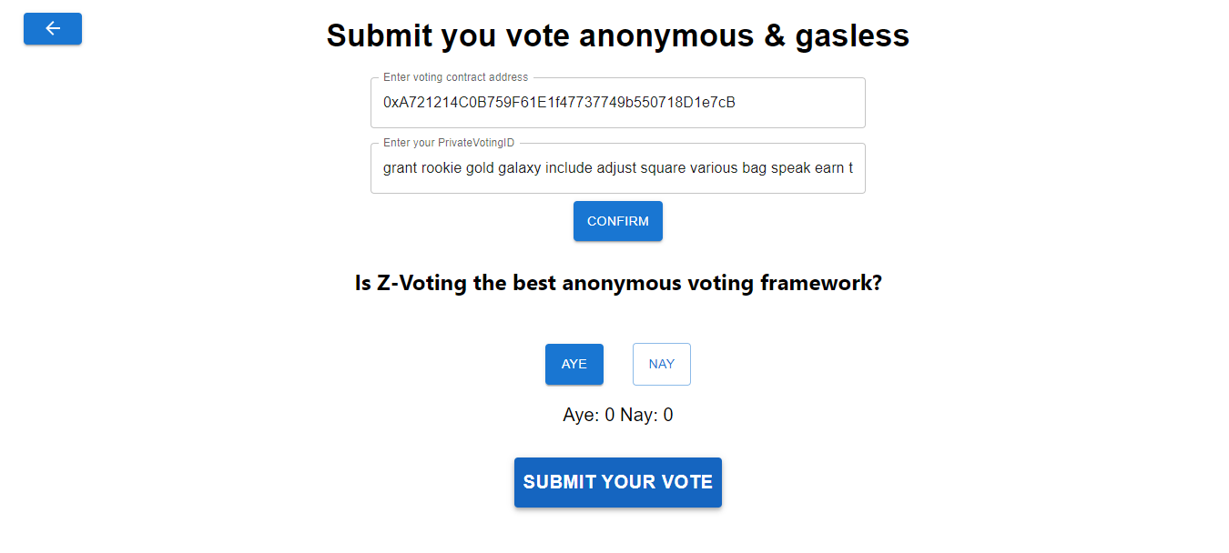

Slide 23
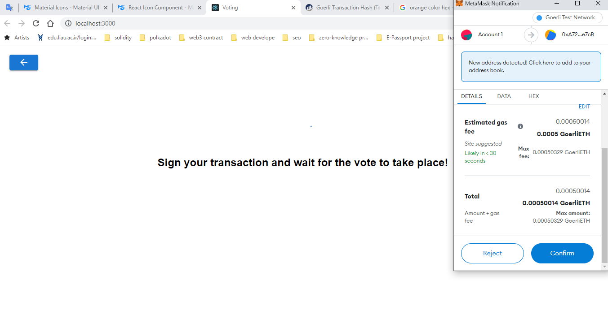

Slide 24
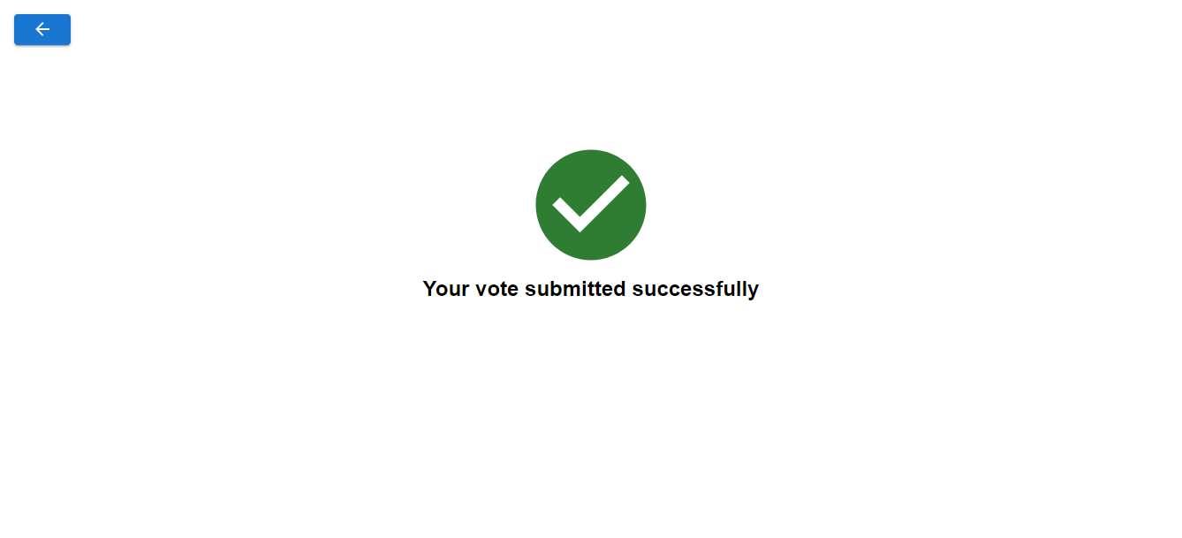

Slide 25
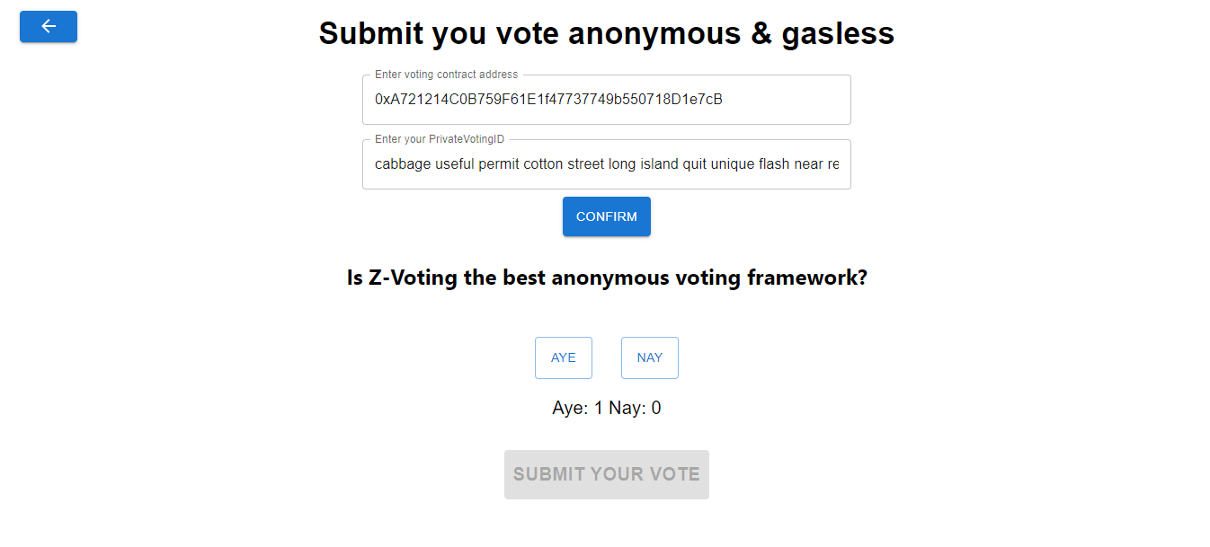

Slide 26
Thanks for your attention

